Slide 1

Fortress engineering
Presenter : Kriti Bhayani, CEO, Epic Soul LLC

Slide 2
Introduction:
Hailing from a background of Oil & Gas Engineering, the Epic Soul holds the experience required to contact.
We are connected to a government contracting team of experts with over 10 years’ experience and over a billion dollars in revenue that has offered to assist with getting the first contract.
Access to all military bases provides us an edge by giving us access to all contracting officers at the Department of Defense and VA.
We are in process of attaining membership of Women’s Business Enterprise Alliance(WBEA) which would give us opportunities to connect with the federal contracting officials and events.

Slide 3
Fortress engineering
Mission
Our mission is to provide engineering solutions that fulfill our clients goals. Senior experience allows us to achieve quality while balancing cost and scheduling objectives.
Engineering Disciplines
Process Engineering
Mechanical Engineering
Project Management
Civil and Structural Engineering
Electrical Engineering
Instrumentation
Automation and Control Systems
Functional Safety Management
Procurement and Expediting
Quality Control
Regulatory and Environment Services

Slide 4
FORTRESS ENGINEERING’S Federal CONTRACTING Industries
Description | 3 Years average Federal contract spending*
Oil & Gas construction | $ 0.40 B
Jet Fueling | $ 7.35 B
Engineering services | $ 33.04 B
* Information procured from www.usaspending.gov

Slide 5
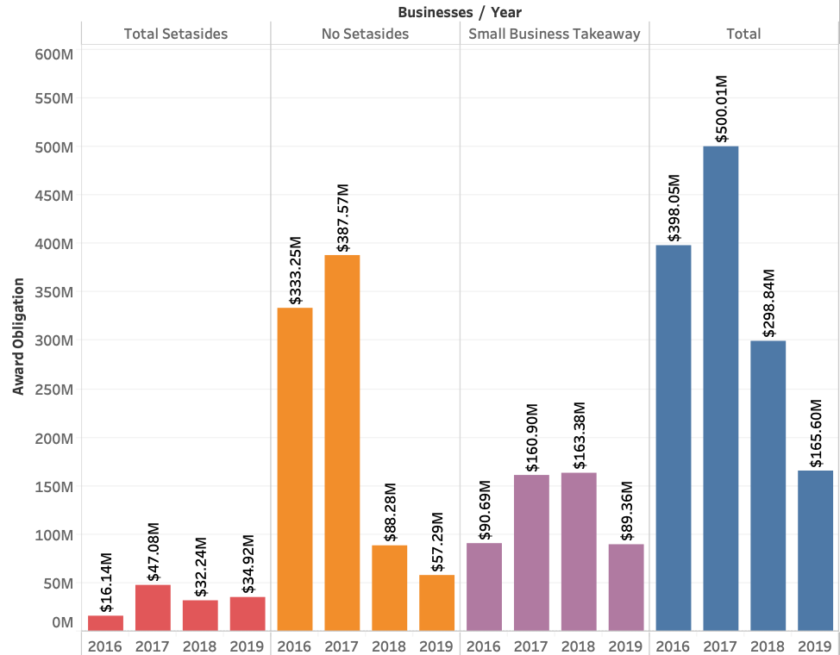
Oil & Gas construction
Small Business Seta-sides
Open Competition
Small Business Awards
Total Awards

Slide 6
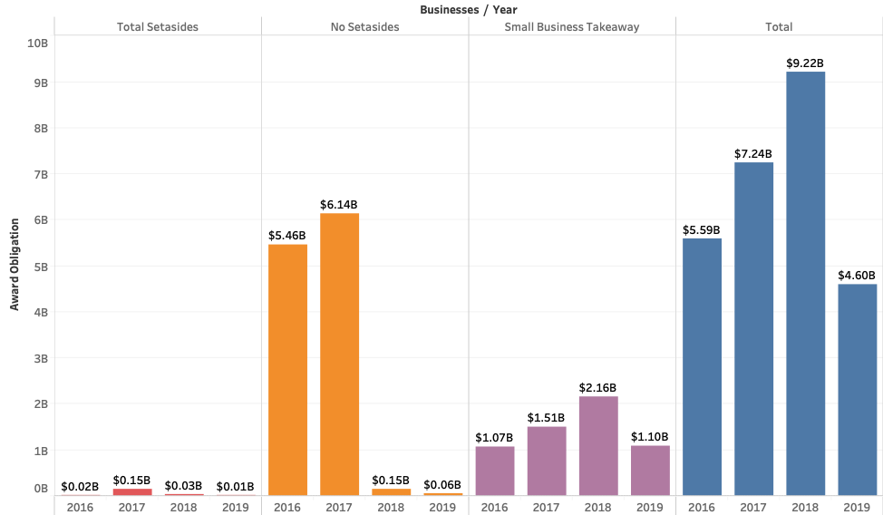
Jet Fueling
Small Business Seta-sides
Open Competition
Small Business Awards
Total Awards

Slide 7
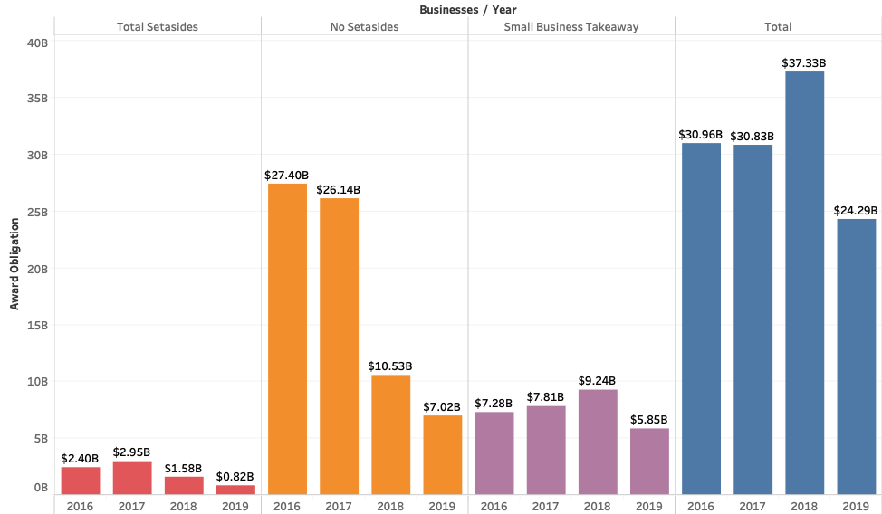
Engineering services
Small Business Seta-sides
Open Competition
Small Business Awards
Total Awards

Slide 8
Top 5 Small Business revenues by industry codes
No. | Oil & Gas Construction | Total 2016, 2017 & 2018 Federal Contract Obligation
1 | STRUCTURAL ASSOCIATES, INC. | $ 44.7 M
2 | DAWSON-POND JV, LLC | $ 43.9 M
3 | RELIABLE CONTRACTING GROUP, LLC | $ 32.0 M
4 | NOVA GROUP, INC. | $ 27.3 M
5 | NOMLAKI TECHNOLOGIES, LLC | $ 22.6 M
No. | Fueling | Total 2016, 2017 & 2018 Federal Contract Obligation
1 | PETROMAX REFINING COMPANY LLC | $ 550.0 M
2 | PETRO STAR INC. | $ 368.9 M
3 | PAR HAWAII REFINING, LLC | $ 348.3 M
4 | U S OIL & REFINING CO | $ 277.2 M
5 | LAZARUS ENERGY HOLDINGS LLC | $ 263.4 M
No. | Engineering Services | Total 2016, 2017 & 2018 Federal Contract Obligation
1 | ADAMS COMMUNICATION & ENGINEERING TECHNOLOGY, INC. | $ 508.6 M
2 | QUANTITECH INC | $ 414.5 M
3 | BRAVURA INFORMATION TECHNOLOGY SYSTEMS INC. | $ 357.1 M
4 | MIRACLE SYSTEMS LLC | $ 273.8 M
5 | CREDENCE MANAGEMENT SOLUTIONS LIMITED LIABILITY COMPANY | $ 212.8 M

Slide 9
Epic soul proposals
Consulting
Joint Venture

Slide 10
Road Map
Q&A
Fortress Engineering & Epic Soul decide to go in business
Client – Consultant Agreement
Client Questionnaire
Registrations
JV - Epic Soul LLC
Capability Statement
Set asides:
Total Small Business
HUBZone
Minority
Woman Owned SB
Company Branding
Federal Biding Account Registration
Bidding

Slide 11
Thank you

Slide 12
APPENDIX

Slide 13
Current Opportunities:
100% Small Business set-aside: Jet fueling Simplified Acquisition Procedures (SAP). he contractor shall provide:
40,000 USG of JET A1 NEAT
Open competition: Jet fueling Delivery of Into-Plane Aviation Fuels for various overseas locations under the purchase program 1.2 AFRICOM. The purchase period of performance is 01 October 2019 through 30 September 2023.
Jet A-1 w/o FSII: 25,945,739 USG Jet A-1 w/FSII: 26,323 USG Turbine Fuel Aviation (TS1): 1,140 USG Jet A-1 w/o FSII & w/FSII Into-Truck: 2,597,206 USG
Open competition: Jet fueling DELIVERY OF INTO-PLANE AVIATION FUELS FOR VARIOUS DOMESTIC LOCATIONS UNDER PURCHASE PROGRAM 2.3 EAST. THE PURCHASE PERIOD IS FROM 5 JULY 2019- 4 JULY 2024. THE FOLLOWING QUANTITIES ARE ESTIMATED:
JET A/O FSII 60,253,582 USG;
JET A W/FSII 102,365,464 USG;
JET A W/FSII (INTO-TRUCK) 1,120,744 USG.
Open competition: Engineering Services IDIQ for structural projects primarily under the cognizance of Naval Facilities Engineering Command, Hawaii. Contract Award Dollar Amount: $100,000,000 maximum

Slide 14
What is required from Fortress Engineering?
‘Support from leadership to do what is necessary to deliver to the government.
Commitment from the company/operations that it will perform when a contract is received.
A current staff member with bandwidth that will assist me with the documentation.

